Slide 1

Financial Analysis
Presented by: Uzman Ansari

Slide 2
Introduction
Objective:
To analyze key financial metrics and trends.
To provide insights into financial performance.
Dataset Overview:
Briefly describe the dataset and its key features
(Time period, financial metrics)
Data Summary
Content:
Summary of the data (number of records, key attributes like revenue, expenses, profit).
Key descriptive statistics (mean, median, max, min).

Slide 3

Descriptive Statistics
Market Capitalization (Mar Cap - Crore):
Mean: ₹31,300.97 Crore
Median (50th percentile): ₹9,097.33 Crore
Maximum: ₹5,83,436.72 Crore (Reliance Industries)
Quarterly Sales (Sales Qtr - Crore):
Mean: ₹4,395.98 Crore
Median: ₹1,278.30 Crore
Maximum: ₹1,10,666.93 Crore (Indian Oil Corporation Ltd)

Slide 4
Descriptive Statistics
Top 10 Companies by Market Capitalization
Reliance Industries: ₹5,83,436.72 Crore
TCS: ₹5,63,709.84 Crore
HDFC Bank: ₹4,82,953.59 Crore
ITC: ₹3,20,985.27 Crore
HDFC: ₹2,89,497.37 Crore
Top 10 Companies by Quarterly Sales
Indian Oil Corporation Ltd (IOCL): ₹1,10,666.93 Crore
Reliance Industries: ₹99,810.00 Crore
Tata Motors: ₹74,156.07 Crore
Bharat Petroleum Corporation Ltd (BPCL): ₹60,616.36 Crore
Hindustan Petroleum Corporation Ltd (HPCL): ₹57,474.25 Crore

Slide 5
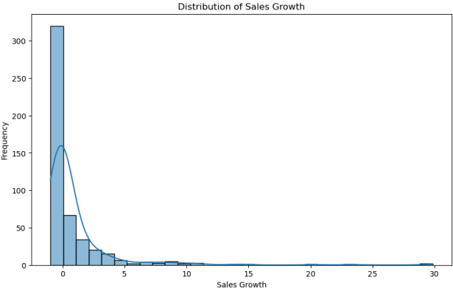
Distribution Of Sales Growth
High Sales Growth:
High sales growth indicates robust business expansion.
Companies experiencing high sales growth often attract investor interest.
Low Sales Growth:
Low sales growth may indicate stagnation or challenges.
Companies experiencing declining sales growth need to reevaluate strategies.

Slide 6
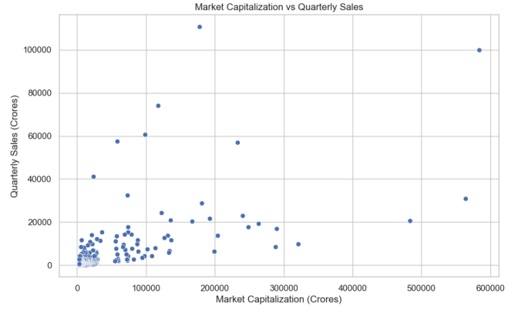
Market Capitalization vs Quarterly Sales

Slide 7
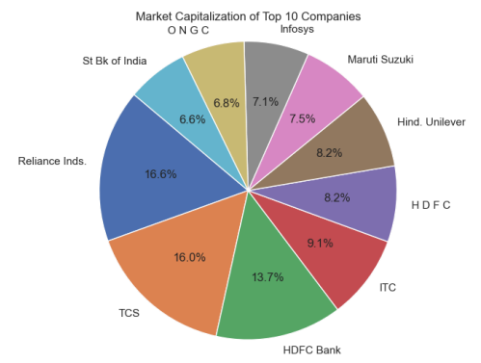
Market Capitalization of Top 10 Companies

Slide 8
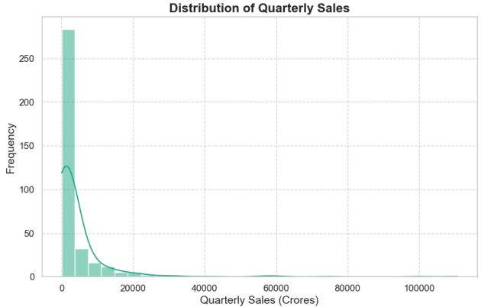

Slide 9
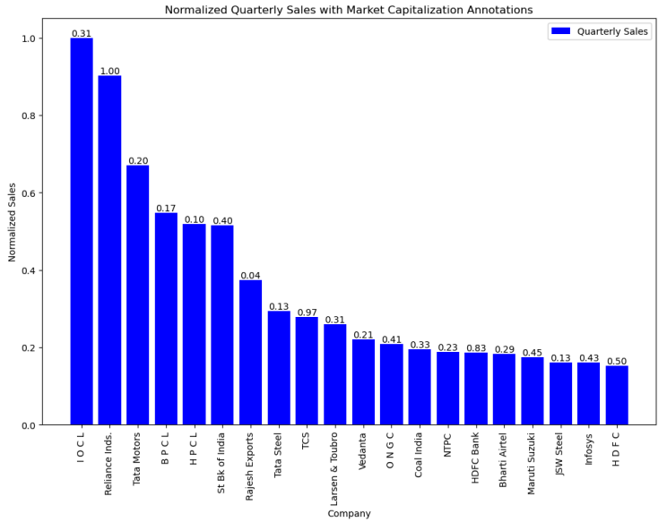
Normalized Quarterly Sales with Market Capitalization Annotations
1. IOCL (Indian Oil Corporation Limited):
Their sales growth and market cap can be influenced by global oil prices,
demand, and government policies.
2. Reliance Industries Limited (RIL):
RIL is a conglomerate with interests in petrochemicals, refining, retail, telecommunications.
Their sales growth has been impressive due to diversification.
The market cap of RIL is substantial, reflecting investor confidence.
3. Tata Motors Limited:
Tata Motors operates in the automobile industry, manufacturing commercial
They've shown good profit growth over the last 5 years.
4. State Bank of India (SBI):
Their sales growth may vary due to economic conditions and lending activities.
5. TATA Steel:
Their sales growth depends on global steel demand and pricing.
6. TCS (Tata Coo TCS is a leading IT services company.
Their sales growth is driven by digital transformation and global demand for IT services.

Slide 10
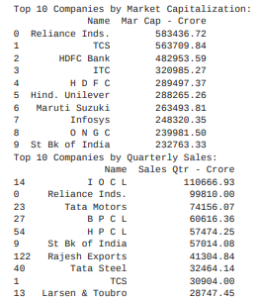
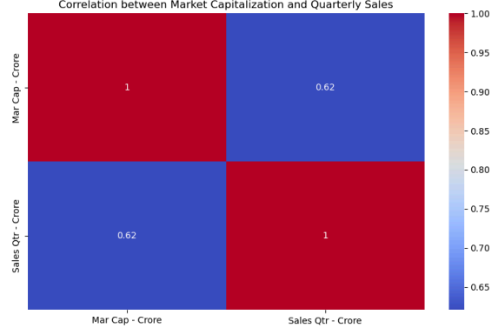
Top 10 Companies by Market Capitalization Top Companies by Quarterly Sales
Correlation between Market Capitalization and Quarterly Sales
Market Capitalization (Mar Cap): This represents the total value of a company's
outstanding shares in the stock market.
Quarterly Sales (Sales Qtrs.): This refers to a company's revenue generated during a
specific quarter (three-month period).

Slide 11
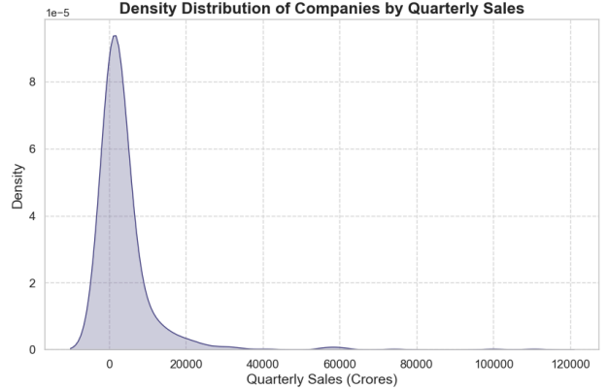
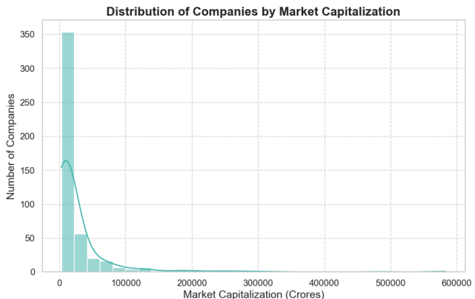
Density Distribution of Companies by Quarterly Sales
Distribution of Companies by Market Capitalization

Slide 12
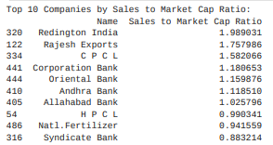
Top IO Companies by Sales to Market Cap Ratio
Redington India: With a ratio of 1.989031, investors are paying approximately <100 for every of Redington India's sales.
Rajesh Exports: Their ratio stands at 1.757986, indicating a similar premium.
CPCL (Chennai Petroleum Corporation Limited): CPCL has a ratio of 1.582066.
Corporation Bank: Their ratio is 1.188653.
Oriental Bank: A ratio of 1.159876 suggests investors are willing to pay more for their sales.
Andhra Bank: Their ratio is 1.118510.
Allahabad Bank: With a ratio of 1.025796, investors are paying a moderate premium.
HPCL (Hindustan Petroleum Corporation Limited): HPCL's ratio is 0.990341.
Natl. Fertilizer (National Fertilizers Limited): Their ratio stands at 0.941559.
Syndicate Bank: The lowest on this list, with a ratio of 0.883214.

